Slide 1
Slides in this lecture are mainly from the book
Cryptography and Network Security
3rd edition
William Stallings
Chapter 2
Others were based on
J. Wang and Z. Kissel. Introduction to Network Security: Theory and Practice
No copyrights were harmed in the making of this lecture

Slide 2
What is Encryption?
There are two approaches to network security
  Crypto based: cryptographic algorithms and security protocols
  System based: non-crypto
  Combination of both forms a standard security structure
Encryption
  Make plain text messages unintelligible
  The unintelligible text can be converted back to its original form

Slide 3
ENCRYPTION
Encryption is most often used to send information between two parties while ensuring that any third party cannot eavesdrop on the data contained.
Encryption can be used for data-in-motion (email PGP , HTTPS etc) or for data at rest (Truecrypt – well…. , HDD encryption, BitLocker etc)

Slide 4
ENCRYPTION
Encryption provides:
Confidentiality: Only the intended recipient can access the data encrypted.
Authentication: The recipient can verify the sender/source if a signed key is used
Integrity: The data cannot be changed in transit without authorised access.
Non-repudiation: if signed, the sender cannot deny their actions.

Slide 5
Symmetric Encryption
or conventional / private-key / single-key
sender and recipient share a common key
all classical encryption algorithms are private-key
was only type prior to invention of public-key in 1970’s
Notes:
All traditional schemes are symmetric / single key / private-key encryption algorithms, with a single key, used for both encryption and decryption, since both sender and receiver are equivalent, either can encrypt or decrypt messages using that common key.

Slide 6
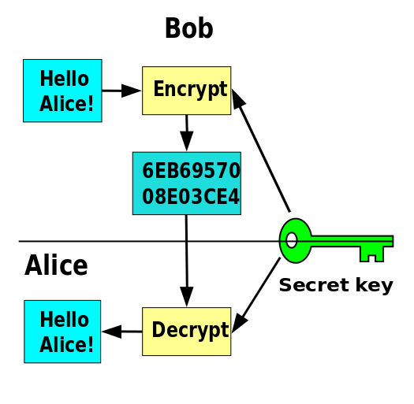
Symmetric Key
Image from wikipedia

Slide 7
Basic Terminology
plaintext - the original message
ciphertext - the coded message
cipher - algorithm for transforming plaintext to ciphertext
key - info used in cipher known only to sender/receiver
encipher (encrypt) - converting plaintext to ciphertext
decipher (decrypt) - recovering ciphertext from plaintext
cryptography - study of encryption principles/methods
cryptanalysis (codebreaking) - the study of principles/ methods of deciphering ciphertext without knowing key
cryptology - the field of both cryptography and cryptanalysis
Notes:
Briefly review some terminology used throughout the course.

Slide 8
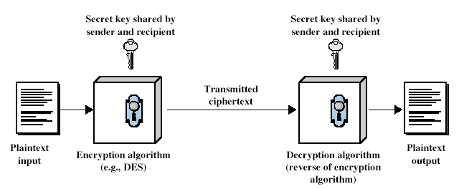
Symmetric Cipher Model
Notes:
Detail 5 ingredients of the symmetric cipher model:
plaintext
encryption algorithm – performs substitutions/transformations on plaintext
secret key – control exact substitutions/transformations used in encryption algorithm
ciphertext
decryption algorithm – inverse of encryption algorithm

Slide 9
Requirements
two requirements for secure use of symmetric encryption:
  a strong encryption algorithm
  a secret key known only to sender / receiver
  Y = E_{K}(X)
  X = D_{K}(Y)
assume encryption algorithm is known
implies a secure channel to distribute key
Notes:
Generally assume that the algorithm is known.
This allows easy distribution of s/w and h/w implementations.
Hence assume just keeping key secret is sufficient to secure encrypted messages.
Have plaintext X, ciphertext Y, key K, encryption alg Ek, decryption alg Dk.

Slide 10
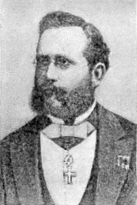
Kerschoff’s Principle
The system must be practically, if not mathematically, indecipherable;
It should not require secrecy, and it should not be a problem if it falls into enemy hands;
It must be possible to communicate and remember the key without using written notes, and correspondents must be able to change or modify it at will;
It must be applicable to telegraph communications;
It must be portable, and should not require several persons to handle or operate;
Lastly, given the circumstances in which it is to be used, the system must be easy to use and should not be stressful to use or require its users to know and comply with a long list of rules

Slide 11
Cryptography
can be characterised by:
  type of encryption operations used
    substitution / transposition / product
  number of keys used
    single-key or private / two-key or public
  way in which plaintext is processed
    block / stream

Slide 12
Things to know
Any message written over a fixed set of symbols can be represented as a binary string (a sequence of 0's and 1's)
Binary digits 0 and 1 are called bits
To reduce computation overhead, encryption algorithms should only use operations that are easy to implement

Slide 13
ASCII | HEX | Binary
A | 41 | 0100 0001
a | 61 | 0110 0001
B | 42 | 0100 0010
b | 62 | 0110 0010
C | 43 | 0100 0011
c | 63 | 0110 0011
space | 20 | 0010 0000
Tab | 9 | 0000 1001

Slide 14
Types of Cryptanalytic Attacks
ciphertext only
  only know algorithm / ciphertext, statistical, can identify plaintext
known plaintext
  know/suspect plaintext & ciphertext to attack cipher
chosen plaintext
  select plaintext and obtain ciphertext to attack cipher
chosen ciphertext
  select ciphertext and obtain plaintext to attack cipher
chosen text
  select either plaintext or ciphertext to en/decrypt to attack cipher

Slide 15
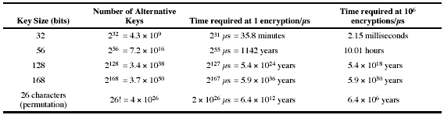
Brute Force Search
always possible to simply try every key
most basic attack, proportional to key size
assume either know / recognise plaintext

Slide 16
More Definitions
unconditional security
  no matter how much computer power is available, the cipher cannot be broken since the ciphertext provides insufficient information to uniquely determine the corresponding plaintext
computational security
  given limited computing resources (eg time needed for calculations is greater than age of universe), the cipher cannot be broken
Notes:
Unconditional security would be nice, but the only known such cipher is the one-time pad (later). For all reasonable encryption algorithms, have to assume computational security where it either takes too long, or is too expensive, to bother breaking the cipher.

Slide 17
Classical Substitution Ciphers
where letters of plaintext are replaced by other letters or by numbers or symbols
or if plaintext is viewed as a sequence of bits, then substitution involves replacing plaintext bit patterns with ciphertext bit patterns
Notes:
In this section and the next, we examine a sampling of what might be called classical encryption
techniques. A study of these techniques enables us to illustrate the basic approaches to
symmetric encryption used today and the types of cryptanalytic attacks that must be anticipated.
The two basic building blocks of all encryption techniques: substitution and transposition.
We examine these in the next two sections. Finally, we discuss a system that combine both
substitution and transposition.

Slide 18
Caesar Cipher
earliest known substitution cipher
by Julius Caesar
first attested use in military affairs
replaces each letter by 3rd letter on
example:
  meet me after the toga party
  PHHW PH DIWHU WKH WRJD SDUWB
Notes:
Substitution ciphers form the first of the fundamental building blocks. The core idea is to replace one basic unit (letter/byte) with another. Whilst the early Greeks described several substitution ciphers, the first attested use in military affairs of one was by Julius Caesar, described by him in Gallic Wars (cf. Kahn pp83-84). Still call any cipher using a simple letter shift a caesar cipher, not just those with shift 3.
Note: when letters are involved, the following conventions are used in this course: Plaintext is always in lowercase; ciphertext is in uppercase; key values are in italicized lowercase.

Slide 19
Caesar Cipher
can define transformation as:
  a b c d e f g h i j k l m n o p q r s t u v w x y z
  D E F G H I J K L M N O P Q R S T U V W X Y Z A B C
mathematically give each letter a number
  a b c d e f g h i j k l m
  0 1 2 3 4 5 6 7 8 9 10 11 12
  n o p q r s t u v w x y Z
  13 14 15 16 17 18 19 20 21 22 23 24 25
then have Caesar cipher as:
  C = E(p) = (p + k) mod (26)
  p = D(C) = (C – k) mod (26)
Notes:
This mathematical description uses modulo arithmetic (ie clock arithmetic). Here, when you reach Z you go back to A and start again. Mod 26 implies that when you reach 26, you use 0 instead (ie the letter after Z, or 25 + 1 goes to A or 0).
Example: howdy (7,14,22,3,24) encrypted using key f (5) is MTBID

Slide 20
Cryptanalysis of Caesar Cipher
only have 26 possible ciphers
  A maps to A,B,..Z
could simply try each in turn
a brute force search
given ciphertext, just try all shifts of letters
do need to recognize when have plaintext
eg. break ciphertext "GCUA VQ DTGCM"
Notes:
With a caesar cipher, there are only 26 possible keys, of which only 25 are of any use, since mapping A to A etc doesn't really obscure the message! cf. basic rule of cryptanalysis "check to ensure the cipher operator hasn't goofed and sent a plaintext message by mistake"!
Can try each of the keys (shifts) in turn, until can recognise the original message. See Stallings Fig 2.3 for example of search.
Note: as mentioned before, do need to be able to recognise when have an original message (ie is it English or whatever). Usually easy for humans, hard for computers. Though if using say compressed data could be much harder.
Example "GCUA VQ DTGCM" when broken gives "easy to break", with a shift of 2 (key C).

Slide 21
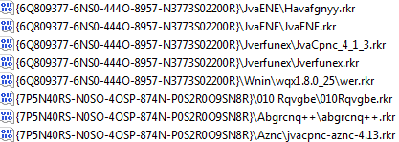
Caesar Cipher still in use
HKEY_CURRENT_USER\Software\Microsoft\Windows\CurrentVersion\Explorer\UserAssist

Slide 22
Monoalphabetic Cipher
rather than just shifting the alphabet
could shuffle (jumble) the letters arbitrarily
each plaintext letter maps to a different random ciphertext letter
hence key is 26 letters long
  Plain: abcdefghijklmnopqrstuvwxyz
  Cipher: DKVQFIBJWPESCXHTMYAUOLRGZN
  Plaintext: ifwewishtoreplaceletters
  Ciphertext: WIRFRWAJUHYFTSDVFSFUUFYA

Slide 23
Monoalphabetic Cipher Security
now have a total of 26! = 4 x 1026 keys
with so many keys, might think is secure
but would be !!!WRONG!!!
problem is language characteristics

Slide 24
Language Redundancy and Cryptanalysis
human languages are redundant
eg "th lrd s m shphrd shll nt wnt"
letters are not equally commonly used
in English e is by far the most common letter
then T,R,N,I,O,A,S
other letters are fairly rare
cf. Z,J,K,Q,X
have tables of single, double & triple letter frequencies
Notes:
As the example shows, we don't actually need all the letters in order to understand written English text. Here vowels were removed, but they're not the only redundancy. cf written Hebrew has no vowels for same reason. Are usually familiar with "party conversations", can hear one person speaking out of hubbub of many, again because of redundancy in aural language also. This redundancy is also the reason we can compress text files, the computer can derive a more compact encoding without losing any information. Basic idea is to count the relative frequencies of letters, and note the resulting pattern.

Slide 25
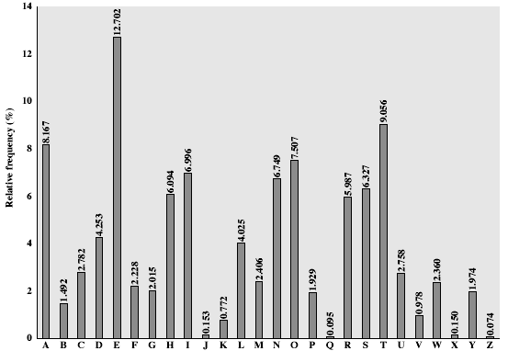
English Letter Frequencies
Notes:
This graph is based on counts done at ADFA in the late 1980's, and used to develop the tables published in Seberry & Pieprzyk [SEBE89].
Note that all human languages have varying letter frequencies, though the number of letters and their frequencies varies.
Seberry & Pieprzyk [SEBE89] Appendix A has graphs for 20 languages (most European & Japanese & Malay).

Slide 26
Use in Cryptanalysis
key concept - monoalphabetic substitution ciphers do not change relative letter frequencies
discovered by Arabian scientists in 9th century
calculate letter frequencies for ciphertext
compare counts/plots against known values
if Caesar cipher look for common peaks/troughs
  peaks at: A-E-I triple, NO pair, RST triple
  troughs at: JK, X-Z
for monoalphabetic must identify each letter
  tables of common double/triple letters help
Notes:
The simplicity and strength of the monoalphabetic substitution cipher meant it dominated cryptographic use for the first millenium AD. It was broken by Arabic scientists. The earliest known description is in Abu al-Kindi's "A Manuscript on Deciphering Cryptographic Messages", published in the 9th century but only rediscovered in 1987 in Istanbul, but other later works also attest to their knowledge of the field.

Slide 27
Example
  UZQSOVUOHXMOPVGPOZPEVSGZWSZOPFPESXUDBMETSXAIZ
  VUEPHZHMDZSHZOWSFPAPPDTSVPQUZWYMXUZUHSX
  EPYEPOPDZSZUFPOMBZWPFUPZHMDJUDTMOHMQ

Slide 28
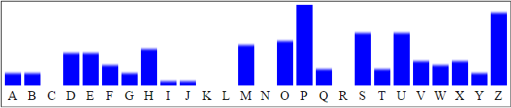
Example
  UZQSOVUOHXMOPVGPOZPEVSGZWSZOPFPESXUDBMETSXAIZ
  VUEPHZHMDZSHZOWSFPAPPDTSVPQUZWYMXUZUHSX
  EPYEPOPDZSZUFPOMBZWPFUPZHMDJUDTMOHMQ
A 2
B 2
C 0
D 6
E 6
F 4
G 2
H 7
I 1
J 1
K 0
L 0
M 8
N 0
O 9
P 16
Q 3
R 0
S 10
T 3
U 10
V 5
W 4
X 5
Y 2
Z 14

Slide 29
Example Cryptanalysis
given ciphertext:
  UZQSOVUOHXMOPVGPOZPEVSGZWSZOPFPESXUDBMETSXAIZ
  VUEPHZHMDZSHZOWSFPAPPDTSVPQUZWYMXUZUHSX
  EPYEPOPDZSZUFPOMBZWPFUPZHMDJUDTMOHMQ
count relative letter frequencies
guess P & Z are e and t
guess ZW is th and hence ZWP is the
proceeding with trial and error fially get:
  it was disclosed yesterday that several informal but
  direct contacts have been made with political
  representatives of the viet cong in moscow

Slide 30
Playfair Cipher
not even the large number of keys in a monoalphabetic cipher provides security
one approach to improving security was to encrypt multiple letters
the Playfair Cipher is an example
invented by Charles Wheatstone in 1854, but named after his friend Baron Playfair
Notes:
Consider ways to reduce the "spikyness" of natural language text, since if just map one letter always to another, the frequency distribution is just shuffled. One approach is to encrypt more than one letter at once. Playfair cipher is an example of doing this.

Slide 31
Playfair Key Matrix
a 5X5 matrix of letters based on a keyword
fill in letters of keyword (sans duplicates)
fill rest of matrix with other letters of the alphabet (I and J are treated as one)
eg. using the keyword MONARCHY
M | O | N | A | R
C | H | Y | B | D
E | F | G | I | K
L | P | Q | S | T
U | V | W | X | Z
Notes:
Have here the rules for filling in the 5x5 matrix, L to R, top to bottom, first with keyword after duplicate letters have been removed, and then with the remain letters, with I/J used as a single letter. This example comes from Dorothy Sayer's book "Have His Carcase", in which Lord Peter Wimsey solves this, and describes the use of a probably word attack.

Slide 32
Encrypting and Decrypting
plaintext encrypted two letters at a time:
  if a pair is a repeated letter, insert a filler like 'X', eg. "balloon" encrypts as "ba lx lo on"
  if both letters fall in the same row, replace each with letter to right (wrapping back to start from end), eg. “ar" encrypts as "RM"
M | O | N | A | R
C | H | Y | B | D
E | F | G | I | K
L | P | Q | S | T
U | V | W | X | Z
Notes:
Note the various rules, and how you wrap from right side back to left, or from bottom back to top. Decrypting of course works exactly in reverse. Can see this by working the example pairs shown, backwards.

Slide 33
Encrypting and Decrypting
plaintext encrypted two letters at a time:
  if both letters fall in the same column, replace each with the letter below it (again wrapping to top from bottom), eg. “mu" encrypts to "CM"
M | O | N | A | R
C | H | Y | B | D
E | F | G | I | K
L | P | Q | S | T
U | V | W | X | Z
Notes:
Note the various rules, and how you wrap from right side back to left, or from bottom back to top. Decrypting of course works exactly in reverse. Can see this by working the example pairs shown, backwards.

Slide 34
Encrypting and Decrypting
plaintext encrypted two letters at a time:
  otherwise each letter is replaced by the one in its row in the column of the other letter of the pair, eg. “hs" encrypts to "BP", and “ea" to "IM" or "JM" (depending)
M | O | N | A | R
C | H | Y | B | D
E | F | G | I | K
L | P | Q | S | T
U | V | W | X | Z
Notes:
Note the various rules, and how you wrap from right side back to left, or from bottom back to top. Decrypting of course works exactly in reverse. Can see this by working the example pairs shown, backwards.

Slide 35
Security of the Playfair Cipher
security much improved over monoalphabetic
since have 26 x 26 = 676 digrams
would need a 676 entry frequency table to analyse (verses 26 for a monoalphabetic)
and correspondingly more ciphertext
was widely used for many years (eg. US & British military in WW1)
it can be broken, given a few hundred letters
since still has much of plaintext structure

Slide 36
Polyalphabetic Ciphers
another approach to improving security is to use multiple cipher alphabets
called polyalphabetic substitution ciphers
makes cryptanalysis harder with more alphabets to guess and flatter frequency distribution
use a key to select which alphabet is used for each letter of the message
use each alphabet in turn
repeat from start after end of key is reached
Notes:
One approach to reducing the "spikyness" of natural language text is used the Playfair cipher which encrypts more than one letter at once. We now consider the other alternative, using multiple cipher alphabets in turn. This gives the attacker more work, since many alphabets need to be guessed, and because the frequency distribution is more complex, since the same plaintext letter could be replaced by several ciphertext letters, depending on which alphabet is used.

Slide 37
Vigenère Cipher
simplest polyalphabetic substitution cipher is the Vigenère Cipher
effectively multiple caesar ciphers
key is multiple letters long K = k1 k2 ... kd
i^{th} letter specifies i^{th} alphabet to use
use each alphabet in turn
repeat from start after d letters in message
decryption simply works in reverse
Notes:
Simply create a set of caesar cipher translation alphabets, then use each in turn, as shown next.

Slide 38
Example
write the plaintext out
write the keyword repeated above it
use each key letter as a caesar cipher key
encrypt the corresponding plaintext letter
eg using keyword deceptive
  key: deceptivedeceptivedeceptive
  plaintext: wearediscoveredsaveyourself
  ciphertext:ZICVTWQNGRZGVTWAVZHCQYGLMGJ

Slide 39
Aids
simple aids can assist with en/decryption
a Saint-Cyr Slide is a simple manual aid
  a slide with repeated alphabet
  line up plaintext 'A' with key letter, eg 'C'
  then read off any mapping for key letter
can bend round into a cipher disk
or expand into a Vigenère Tableau

Slide 40
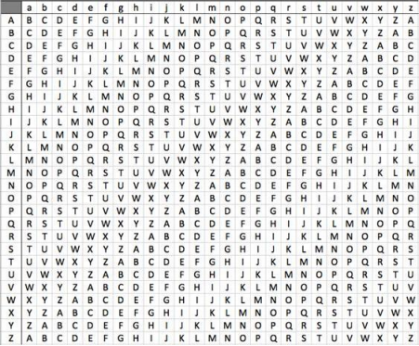

Slide 41
Security of Vigenère Ciphers
have multiple ciphertext letters for each plaintext letter
hence letter frequencies are obscured
but not totally lost
start with letter frequencies
  see if look monoalphabetic or not
if not, then need to determine number of alphabets, since then can attach each

Slide 42
Kasiski Method
method developed by Babbage / Kasiski
repetitions in ciphertext give clues to period
so find same plaintext an exact period apart
which results in the same ciphertext
of course, could also be random fluke
eg repeated “VTW” in previous example
suggests size of 3 or 9
then attack each monoalphabetic cipher individually using same techniques as before
Notes:
For some centuries the Vigenère cipher was le chiffre indéchiffrable (the unbreakable cipher). As a result of a challenge, it was broken by Charles Babbage (the inventor of the computer) in 1854 but kept secret (possibly because of the Crimean War - not the first time governments have kept advances to themselves!). The method was independently reinvented by a Prussian - Friedrich Kasiski who published the attack now named after him in 1863. However lack of major advances meant that various polyalphabetic substitution ciphers were used into the 20C. One very famous incident was the breaking of the Zimmermann telegram in WW1 which resulted in the USA entering the war.
In general the approach is to find a number of duplicated sequences, collect all their distances apart, look for common factors, remembering that some will be random flukes and need to be discarded. Now have a series of monoalphabetic ciphers, each with original language letter frequency characteristics. Can attack these in turn to break the cipher.

Slide 43
Autokey Cipher
ideally want a key as long as the message
Vigenère proposed the autokey cipher
with keyword is prefixed to message as key
knowing keyword can recover the first few letters
use these in turn on the rest of the message
but still have frequency characteristics to attack
eg. given key deceptive
  key: deceptivewearediscoveredsav
  plaintext: wearediscoveredsaveyourself
  ciphertext:ZICVTWQNGKZEIIGASXSTSLVVWLA
Notes:
See that the key used is the keyword "DECEPTIVE" prefixed to as much of the message "WEAREDISCOVEREDSAV" as is needed. When deciphering, recover the first 9 letters using the keyword "DECEPTIVE". Then instead of repeating the keyword, start using the recovered letters from the message "WEAREDISC". As recover more letters, have more of key to recover later letters.
Problem is that the same language characteristics are used by the key as the message. ie. a key of 'E' will be used more often than a 'T' etc
hence an 'E' encrypted with a key of 'E' occurs with probability (0.1275)2 = 0.01663, about twice as often as a 'T' encrypted with a key of 'T'
have to use a larger frequency table, but it exists given sufficient ciphertext this can be broken.

Slide 44
XOR Encryption
The exclusive-OR operation, denoted by ⊕ or XOR, is a simple binary operation used in encryption
XOR encryption: Divide a string into blocks of equal length and encrypt each block with a secret key of the same size of the block

Slide 45
XOR Encryption Example
Block size of 8 (1 byte), on a two character (2 byte) string M
An 8-bit Encryption key (such as: 1100 1010) on M twice:
M: 1111 1111 0000 0000
K: ⊕ 1100 1010 1100 1010
C: 0011 0101 1100 1010
We can decrypt C using the same key; i.e., we simply XOR C with K to get M:
C: 0011 0101 1100 1010
K: ⊕ 1100 1010 1100 1010
M: 1111 1111 0000 0000
This is simple and easy to implement
But it is not secure, for knowing any one pair (M_{i},C_{i}) will reveal K:
M_{i} ⊕ C_{i} = M_{i} ⊕ (M_{i} ⊕ K) = K

Slide 46
One-Time Pad
if a truly random key as long as the message is used, the cipher will be secure
called a One-Time pad
is unbreakable since ciphertext bears no statistical relationship to the plaintext
since for any plaintext & any ciphertext there exists a key mapping one to other
can only use the key once though
have problem of safe distribution of key
Notes:
The One-Time Pad is an evolution of the Vernham cipher, which was invented by Gilbert Vernham in 1918, and used a long tape of random letters to encrypt the message. An Army Signal Corp officer, Joseph Mauborgne, proposed an improvement using a random key that was truly as long as the message, with no repetitions, which thus totally obscures the original message.
Since any plaintext can be mapped to any ciphertext given some key, there is simply no way to determine which plaintext corresponds to a specific instance of ciphertext.

Slide 47
Transposition Ciphers
now consider classical transposition or permutation ciphers
these hide the message by rearranging the letter order
without altering the actual letters used
can recognise these since have the same frequency distribution as the original text
Notes:
Transposition Ciphers form the second basic building block of ciphers. The core idea is to rearrange the order of basic units (letters/bytes/bits) without altering their actual values.

Slide 48
Rail Fence cipher
write message letters out diagonally over a number of rows
then read off cipher row by row
eg. write message out as:
  m e m a t r h t g p r y
  e t e f e t e o a a t
giving ciphertext
  MEMATRHTGPRYETEFETEOAAT
Notes:
Example message is: "meet me after the toga party" with a rail fence of depth 2.

Slide 49
Row Transposition Ciphers
a more complex scheme
write letters of message out in rows over a specified number of columns
then reorder the columns according to some key before reading off the rows
  Key: 3 4 2 1 5 6 7
  Plaintext: a t t a c k p
  o s t p o n e
  d u n t i l t
  w o a m x y z
  Ciphertext: TTNAAPTMTSUOAODWCOIXKNLYPETZ

Slide 50
Product Ciphers
ciphers using substitutions or transpositions are not secure because of language characteristics
hence consider using several ciphers in succession to make harder, but:
  two substitutions make a more complex substitution
  two transpositions make more complex transposition
  but a substitution followed by a transposition makes a new much harder cipher
this is bridge from classical to modern ciphers

Slide 51
Rotor Machines
before modern ciphers, rotor machines were most common product cipher
were widely used in WW2
  German Enigma, Allied Hagelin, Japanese Purple
implemented a very complex, varying substitution cipher
used a series of cylinders, each giving one substitution, which rotated and changed after each letter was encrypted
with 3 cylinders have 26³=17576 alphabets

Slide 52
Steganography
an alternative to encryption
hides existence of message
  using only a subset of letters/words in a longer message marked in some way
  using invisible ink
  hiding in LSB in graphic image or sound file
has drawbacks
  high overhead to hide relatively few info bits

Slide 53
Efficiency
Operations used in the algorithms must be easy to implement on hardware and software
Execution of the algorithms should consume only moderate resources
Time complexity and space complexity must be kept within a small constant factor of the input size
Common operations:
  XOR
  Permutations: one-to-one mapping
  Substitution: many-to-one mapping
  Circular shift: a special form of permutation
  Operations on finite fields

Slide 54
Resistance to Statistical Analysis
Analyzing the frequencies of characters in C, one can find out the original characters in M they correspond to
Diffusion and confusion are standard methods to flatten statistical structure
  Diffusion: Each bit in C should depend on multiple bits (as evenly as possible) in M
    Diffusion can be obtained by executing a fixed sequence of operations for a fixed number of rounds on strings generated from the previous round
  Confusion: Each bit in C should depend on multiple bits (as evenly as possible) in the secrete key K
    Confusion can be obtained by generating sub-keys from K and using different sub-keys in different rounds

Slide 55
Resistance to Brute-Force Attacks
The strength of an encryption algorithm depends on its operations and the key length
Suppose the encryption key is l-bit long, with 2^{l} possible keys
If Eve the eavesdropper attains a ciphertext message C and knows the algorithm used to encrypt it, she can try all keys one at a time until she decrypts the message into something makes sense
Thus, the time complexity of a brute-force attack is in the order of 2^{l}
Under current technologies, it is believed that l = 128 would be sufficient
The time complexity of a brute-force attack is often used as the benchmark for other cryptanalysis attacks: If an attack with a time complexity substantially less than 2^{l} is found, the attack is considered useful

Slide 56
Resistance to Other Attacks
Other common attacks: chosen-plaintext attacks and mathematical attacks
Chosen-plaintext Attacks:
  Obtain a specific M encrypted to C
  Use this pair (M, C) to find out the key used
  Example: XOR encryption
  If Eve knows (M, C) she can find K easily:
  C = (M ⊕ K)
  M ⊕ C = M ⊕ (M ⊕ K)
  M ⊕ C = K!
Mathematical Attacks:
  Use mathematical methods to decipher encrypted messages
    Differential Cryptanalysis, Linear Cryptanalysis, Algebraic Cryptanalysis.
    Require sophisticated mathematics

Slide 57
Implementation Criteria
Implementations of encryption algorithms must resist side channel attacks (SCA)
SCA explores loopholes in the implementation environments
  Timing Attacks: Attacker analyzes the computing time of certain operations
  Useful if the run-time of certain operations varies when the key has different bit values
Combating Timing Attacks:
  Flatten computation time differences by adding redundant operations on instructions that take less time to execute

Slide 58
Data Encryption Standard (DES)
Published by the US National Bureau of Standards (NBS) in 1977
A concrete implementation of the Feistel Cipher Scheme (FCS), invented by Horst Feistel
Symmetrical encryption and decryption structures
Use four basic operations: XOR, permutations, substitution, and circular shift
Widely used from mid-70’s to early-2000’s.
Phased out by AES and other better encryption algorithms

Slide 59
The Feistel Cipher Scheme (FCS)
Divide M into blocks of 2l-bits long (pad the last block if needed)
Use only the XOR and Substitution operations
Generate n sub-keys of a fixed length from the encryption key K: K₁,…,K_{n}
Divide a 2l-bit block input into two parts: L₀ and R₀, both of size l (the suffix and prefix of the block, respectively)
Perform a substitution function F on an l-bit input string and a sub-key to produce an l-bit output
Encryption and decryption each executes n rounds of the same sequence of operations

Slide 60
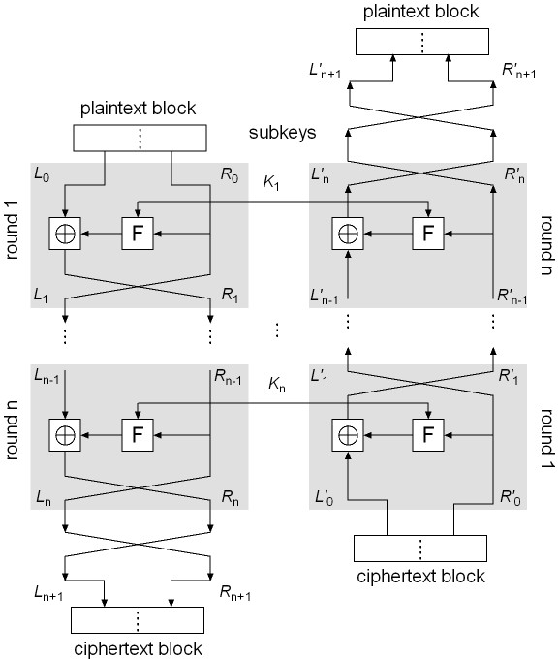
FCS Encryption and Decryption
FCS Encryption
Let M = L₀R₀; execute the following operations in round i, i = 1, …, n:
L_{i} = R_{i–1}
R_{i} = L_{i–1} ⊕ F(R_{i–1}, K_{i})
Let L_{n+1} = R_{n}, R_{n+1} = L_{n} and C = L_{n+1}R_{n+1}
FCS Decryption
Symmetrical to encryption, with sub-keys in reverse order
Rewrite C as C = L’₀R’₀
Execute the following in round i (i = 1, …, n):
L’_{i} = R’_{i–1}
R’_{i} = L’_{i–1} ⊕ F(R’_{i–1}, K’_{n–i+1})
Let L’_{n+1} = R’_{n}, R’_{n+1} = L’_{n}
We will show that M = L’_{n+1}R’_{n+1}
Encryption
Start
Decryption
Start

Slide 61
Encryption
Start
Decryption
Start

Slide 62
DES Sub-Key Generation
The block size of DES is 64 bits and the encryption key is 56 bits, which is represented as a 64-bit string K = k₁ k₂ … k₆₄
DES uses 16 rounds of iterations with 16 sub-keys
Sub-key generation:
  Remove the 8i-th bit (i = 1, 2, …, 8) from K
  Perform an initial permutation on the remaining 56 bits of K, denoted by IP_{key}(K)
  Split this 56-bit key into two pieces: U₀V₀, both with 28 bits
  Perform Left Circular Shift on U₀ and V₀ a defined number of times, producing U_{i}V_{i}:
  U_{i} = LS_{z(i)} (U_{i–1}), V_{i} = LS_{z(i)} (V_{i–1})
  Permute the resulting U_{i}V_{i} using a defined compress permutation, resulting in a 48-bit string as a sub-key, denoted by K_{i}
  K_{i} = P_{key} (U_{i} V_{i} )

Slide 63
DES Substitution Boxes
The DES substitution function F is defined below:
F(R_{i–1}, K_{i}) = P(S(EP(R_{i–1}) ⊕ K_{i})), i = 1,…,16
First, permute R_{i} using EP(R_{i}) to produce a 48-bit string x
Next, XOR x with the 48-bit sub key K_{i} to produce a 48-bit string y
Function S turns y into a 32-bits string z, using eight 4x16 special matrices, called S-boxes
  Each entry in an S-box is a 4-bit string
  Break y into 8 blocks, each with 6-bits
  Use the i^{th} matrix on the i^{th} block b₁b₂b₃b₄b₅b₆
  Let b₁b₆ be the row number, and b₂b₃b₄b₅ the column number, and return the corresponding entry
  Each 6-bit block is turned to a 4-bit string, resulting in a 32-bit string z
Finally, permute z using P to produce the result of DES’s F function
This result, XOR’d with L_{i–1}, is R_{i}

Slide 64
Is DES good enough?
Security strength of DES
  Number of rounds
  Length of encryption key
  Construction of the substitute function
DES was used up to the 1990’s.
People began to take on the DES Challenges to crack DES
Only uses 56-bit keys = 2⁵⁶ ~ 7.2× 10¹⁶ keys
Brute-force will work with current technology
  In 1997 on Internet in a few months
  In 1998 on dedicated h/w (EFF) in a few days
  In 1999 above combined in 22 hours

Slide 65
3DES/2, 2DES and 3DES/3
DES is not a group!
  No two encryptions are the same as a single one: E_{K}(M) != E_{K1}(E_{K2}(M)
We can use Multiple DES
  Take X keys and apply DES Y times to get YDES/X
  We have, e.g., 2DES/2, 3DES/2, 3DES/3
  Can effectively extend the length of encryption keys using existing DES
  Can resist brute-force attacks

Slide 66
Examples
3DES/2:
C = E_{K1}(D_{K2}(E_{K1}(M)))
M = D_{K1}(E_{K2}(D_{K1}(C)))
  Note: Other combinations of EEE and DDD etc are just as secure
  Using two keys to extend the key length to 112 bits, making DES much more secure against brute-force attacks
Notes on 2DES/2:
  2DES/2 uses just as many keys as 3DES/2, extending the key length to 112
  However, 2DES/2 is vulnerable to the meet-in-the-middle attack

Slide 67
Meet-in-the-middle attacks on 2DES
A brute-force attack against 2DES/2 would need to test every combination of K₁ and K₂ to find the proper key (= 2⁵⁶ x 2⁵⁶ = 2¹¹²)
If the attacker gets two pairs (M₁, C₁) and (M₂, C₂) where C_{i} = E_{K2}(E_{K1}(M_{i}))
This means that D_{K2}(C_{i}) = X_{i} =E_{K1}(M_{i}) for both pairs
Make two tables, in one we decrypt C using all possible 56-bit keys, in the other we encrypt M, matching results are a potential match for K₁ and K₂. (We meet in the middle)
The number of pairs (K₁, K₂) that could possibly return equal results on both sides for a pair (M, C) is 2¹¹²/2⁶⁴ = 2⁴⁸.
The number of pairs that could return these results for two pairs M, C is 2⁴⁸/2⁶⁴ = 2⁻¹⁶.
Thus, the possibility of finding (K₁, K₂) is 1-2⁻¹⁶. Very high.
The time complexity is in the vicinity of 2(2⁵⁶ + 2⁴⁸) < 2⁵⁸. Much smaller than 2¹¹²

Slide 68
Summary
have considered:
  classical cipher techniques and terminology
  monoalphabetic substitution ciphers
  cryptanalysis using letter frequencies
  Playfair ciphers
  polyalphabetic ciphers
  transposition ciphers
  product ciphers and rotor machines
  Stenography
  DES
  YDES/X

